Slide 1
GYM WEBSITE WEEK 12 to 17 oct
SIDDHANT C MESHRAM
ROLL 51
11810469

Slide 2
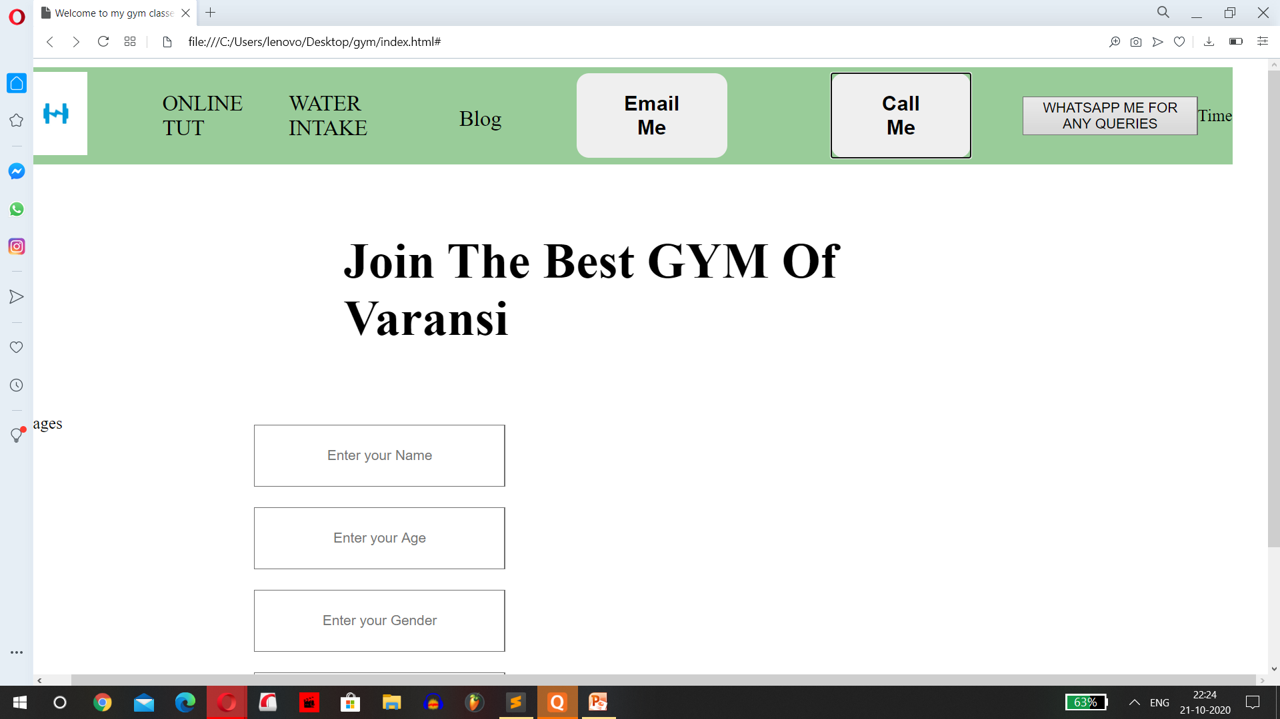
OUTPUT

Slide 3
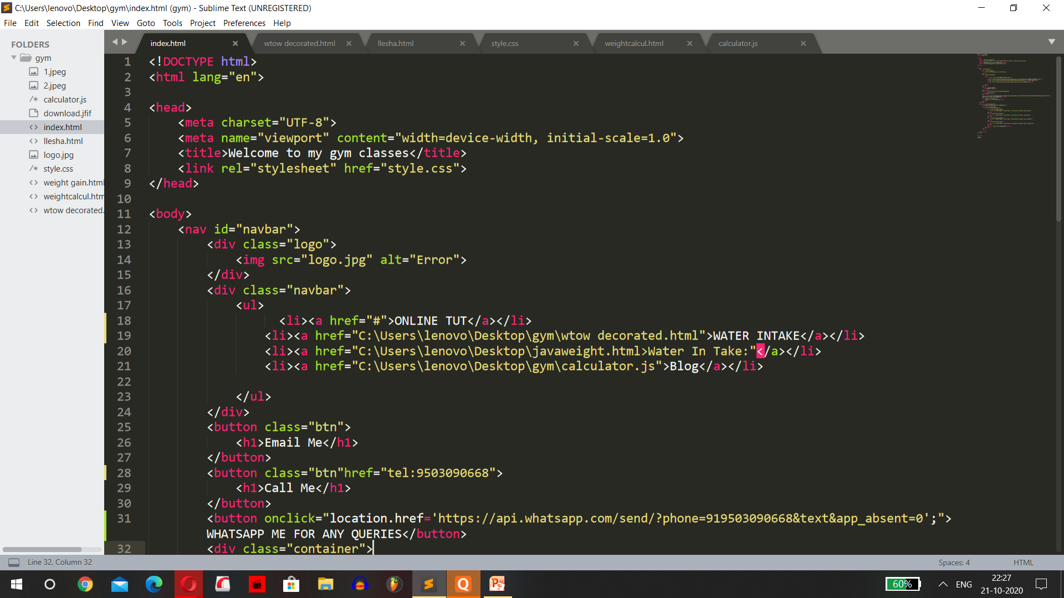
CODE

Slide 4
DESCRIPTION:
In this week I had sucessfully added an whatsapp call feature by using a direct button.
For that I had to setup whatsapp on laptop
And create a link of my whatsapp id.

